Slide 1

Android Forensics
Shobhit 19CS06008
Rohit Agarwal 19CS06002

Slide 2
Contents:
Android OS – all you need to know
Android security model
Bypassing security
Android logical data acquisition
Android physical data acquisition
JTAG forensic examinations
Summary

Slide 3
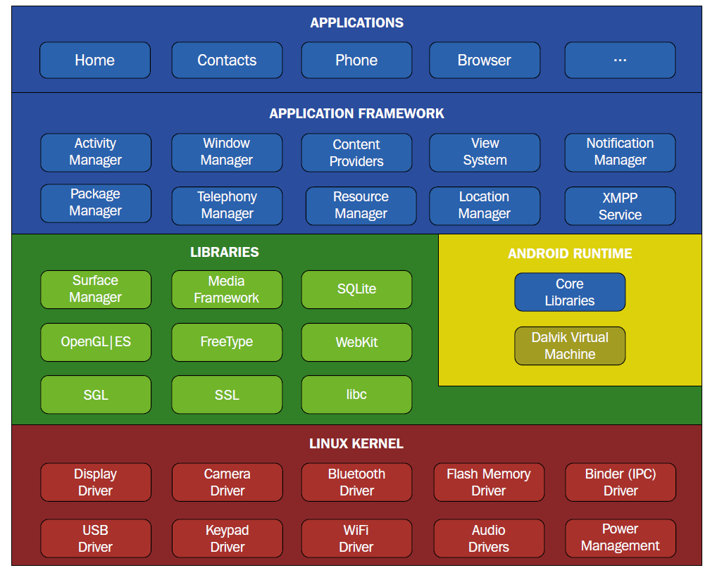
Android OS

Slide 4
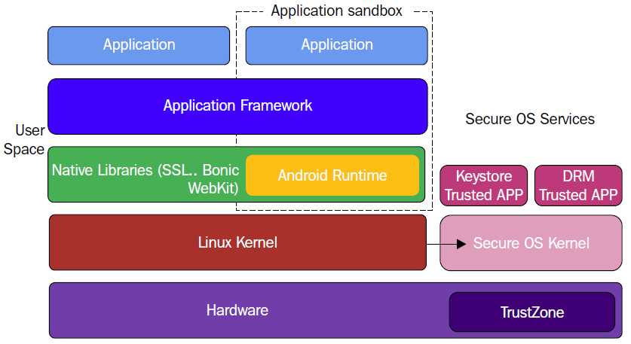
Android Security Model
Full Disk Encryption 2) Application Security

Slide 5
Full Disk Encryption
Full-disk encryption is the process of encoding all user data on an Android device using an encrypted key.
Dm-crypt based encryption.
128 (AES) with cipher-block chaining (CBC) and SHA256.
ForceEncrypt flag is used for fast encryption
On boot Device generated 128-bit master key & then hashes it with a default password & stored salt and a Trusted Execution Environment signs it.
Master key is encrypted by the hash of the signature.
Four kinds of encryption states for re-encrypting the master key : Default, PIN, Password, Pattern

Slide 6
Application Security
Three Main Security features of Application:
Application Sandboxing 2) SELinux 3) Application Signing
Application Sandboxing and Permissions
Own dedicated virtual sandbox.
Every application runs within the application sandbox.
Unique user ID (UID).
Process Level Isolation.
File level Isolation or Resource level Isolation.

Slide 7
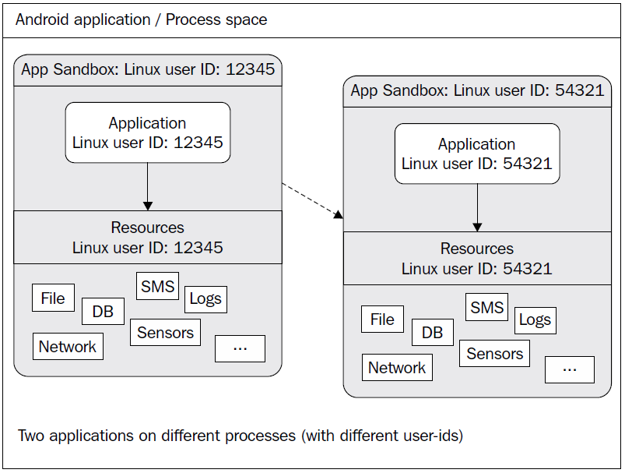
<manifest xmlns:android="http://schemas.android.com/apk/res/android"
package="com.example.soufiane">
<uses-permission android:name="android.permission. CAPTURE_AUDIO_OUTPUT " />
</manifest>

Slide 8
Security Enhanced Linux (SELinux)
SELinux define boundaries for application sandboxes
Automating security policy creation.
Three basic modes of operation: disabled, permissive mode, and enforcing mode.
Application Signing
Authenticity and integrity.
Implemented by a digital signature
The certificate is mainly used to verify that application updates are coming from the right authority.

Slide 9
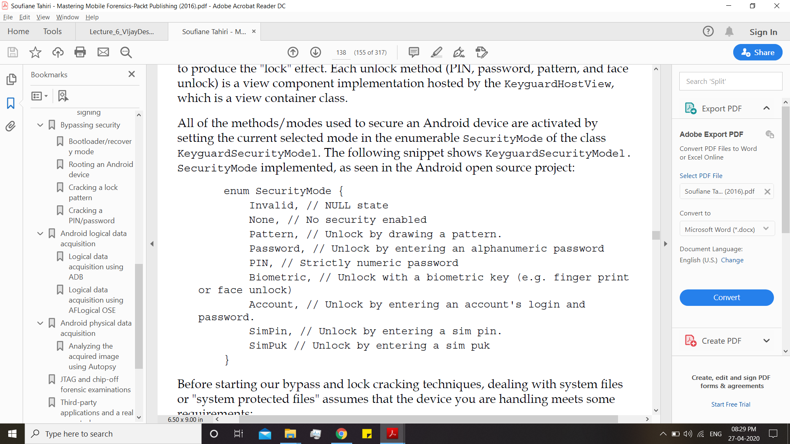
Bypassing Security
Bootloader
Rooting the device
Cracking the lock
pattern
Cracking the pin /
password

Slide 10
Bootloader / Recovery Mode
Bootloader, or fastboot, is a BIOS-like system that packages the instructions to boot an operating system kernel and is designed to run its own debugging environment.
When unlocked allows cold boot attack to recover the key for Android's full disk encryption.
When locked prevents loading custom ROMS, kernels or start-up files on phones.
Limits the phone to mostly manufacturer and the carrier approved software.

Slide 11
Rooting the device
Download and install the KingRoot app directly on the device and run it
The application will verify the root status; if it's not rooted, the application will prompt you to click on Start Root. All you need to do after clicking is to wait until the process finishes
If you are prompted to allow Google to regularly check the device activity for security problems, press Decline. Once done you will get a message telling you root was successfully installed.

Slide 12
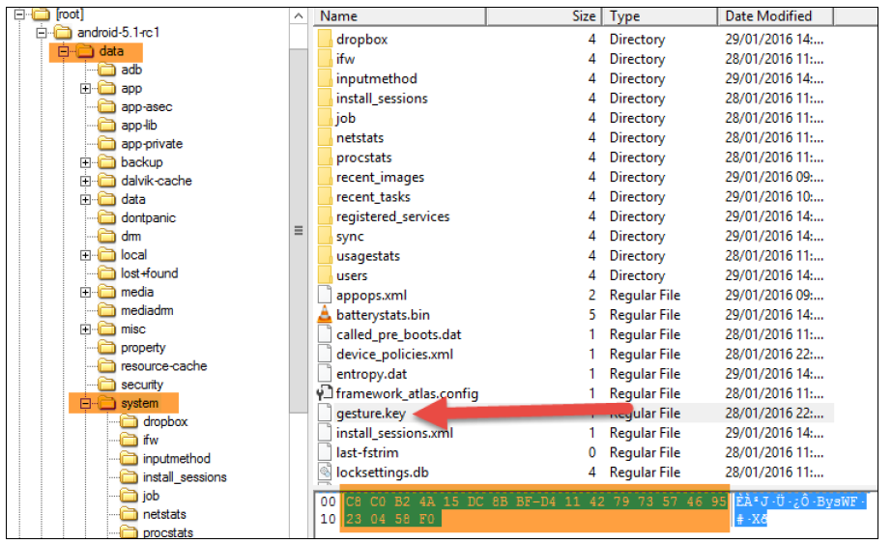
Cracking the Pattern

Slide 13
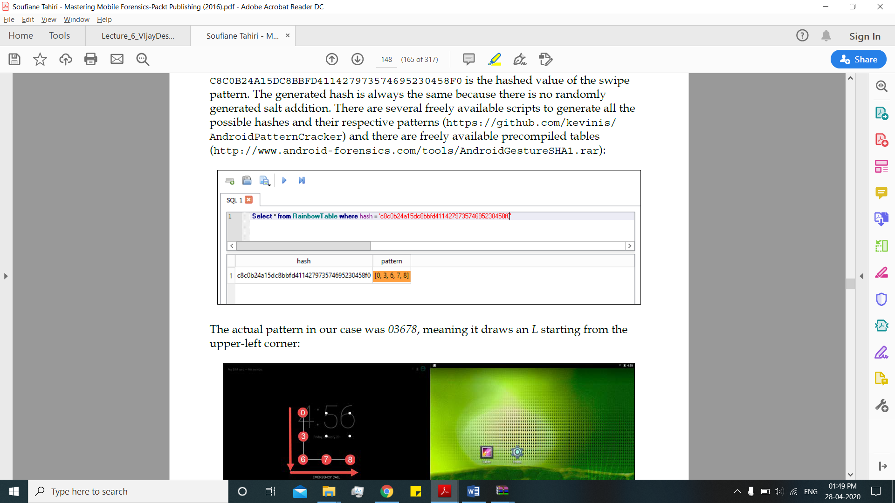
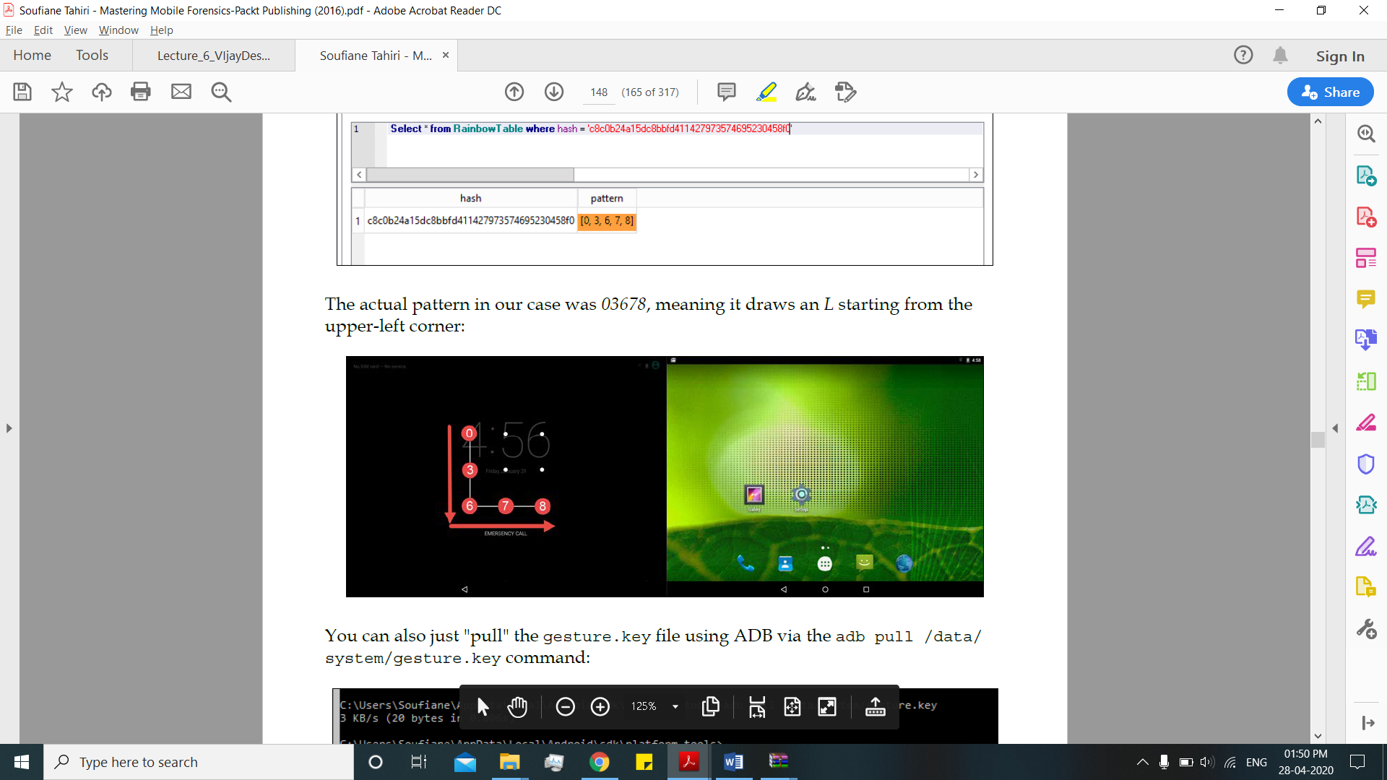

Slide 14
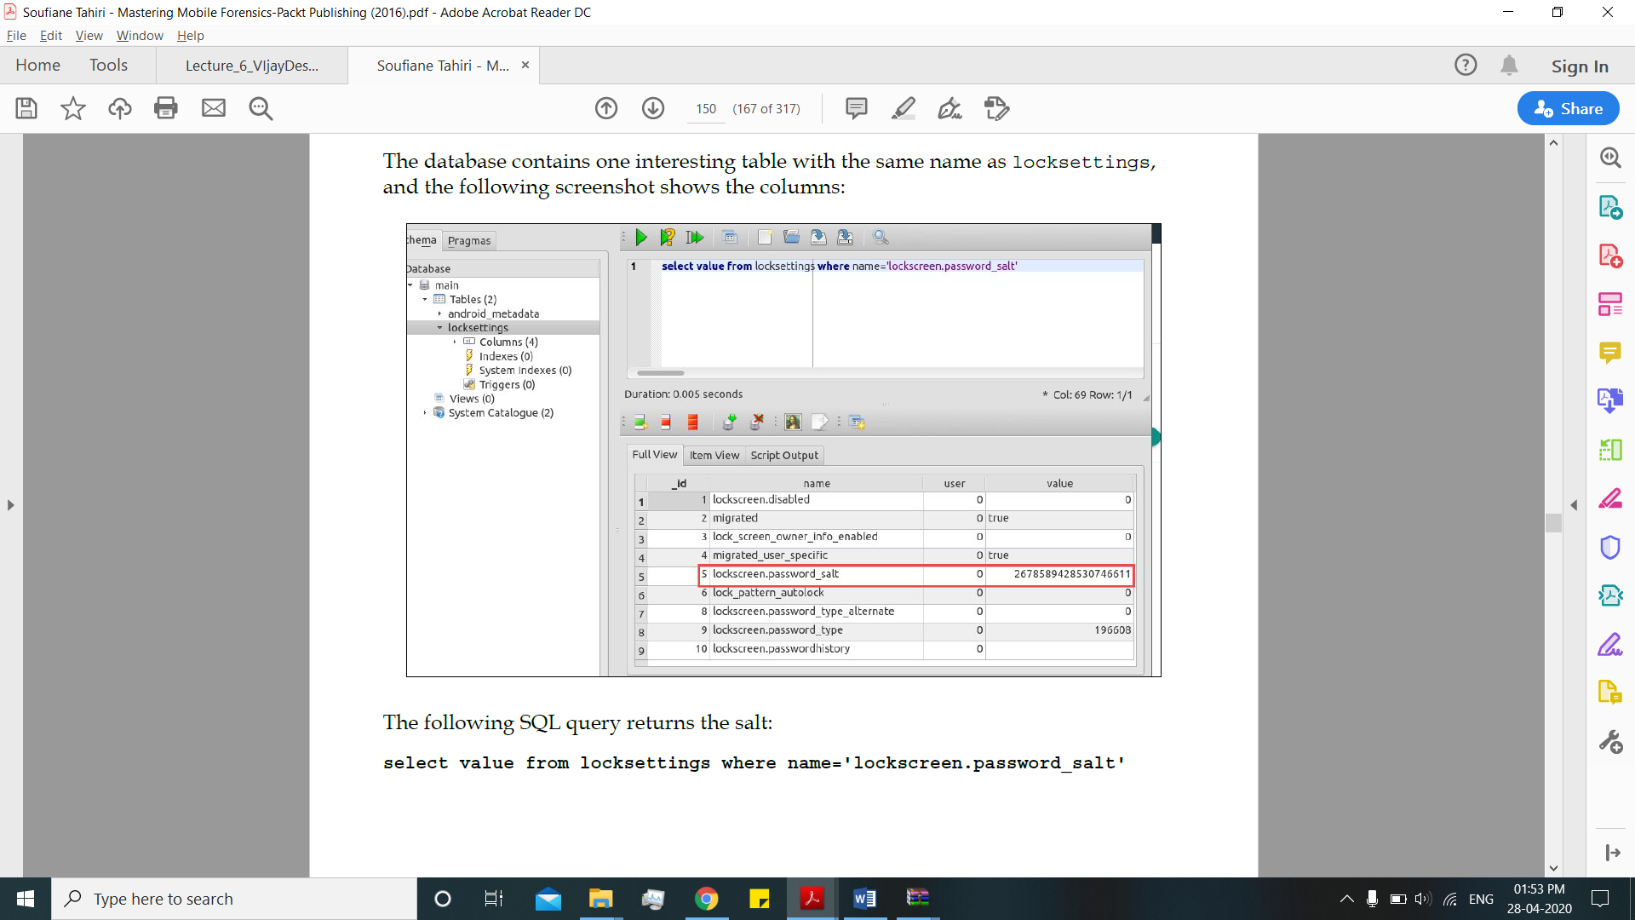
Cracking a Pin / Password
This means that the PIN/password can be seen as password.key = SHA1($pass . $salt).MD5($pass . $salt).

Slide 15
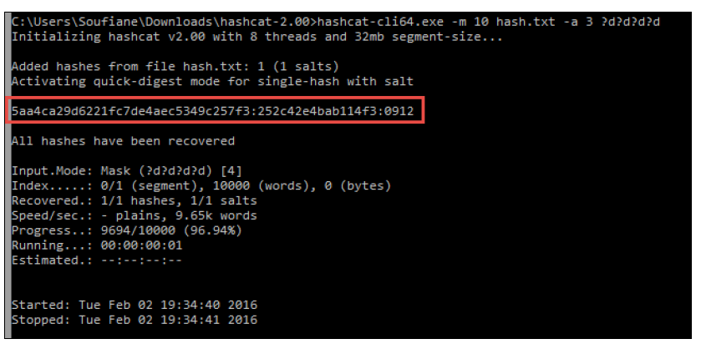

Slide 16
Android Logical Data Acquisition
Gaining root access is a very important step in most Android forensic scenarios, and the decision to root a device or not must be taken with approval from a court of law.
Most of the commercially available forensic tools offer automated, temporary root for Android devices.
If you are willing to do it manually, most of the logical acquisition process in Android devices can be conducted using Android Debug Bridge (ADB) functionalities.
Lets see Some Example…..

Slide 17
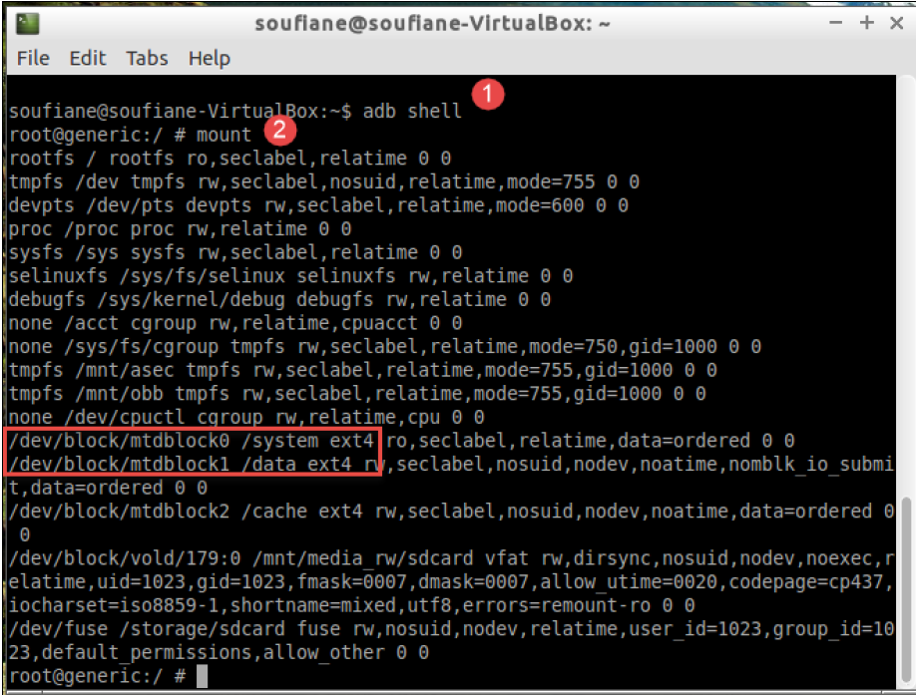
Android Physical Data Acquisition

Slide 18
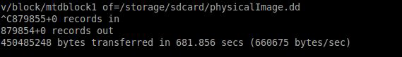
As shown in the preceding screenshot, in my case the SD card is symbolically linked to /storage/sdcard.
And now, using the dd command, we can dump mtdblock1 to /sdcard. The command is as follows
dd if=/dev/block/mtdblock1 of=/storage/sdcard/physicalImage.dd bs=512 conv=notrunc,noerror,sync

Slide 19
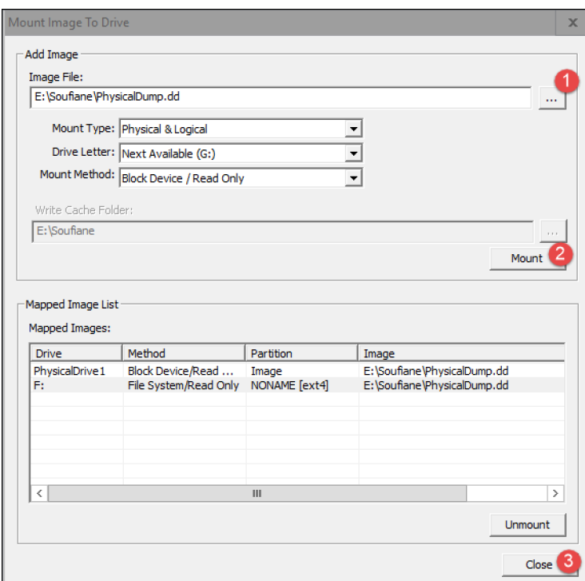
To mount the dumped image, open FTK Imager after downloading and installing it. Click on File | Image Mounting, then click on the Browse button, and locate the Image.dd file you previously acquired. Then click on the Mount button; once the operation succeeds, click on Close:

Slide 20
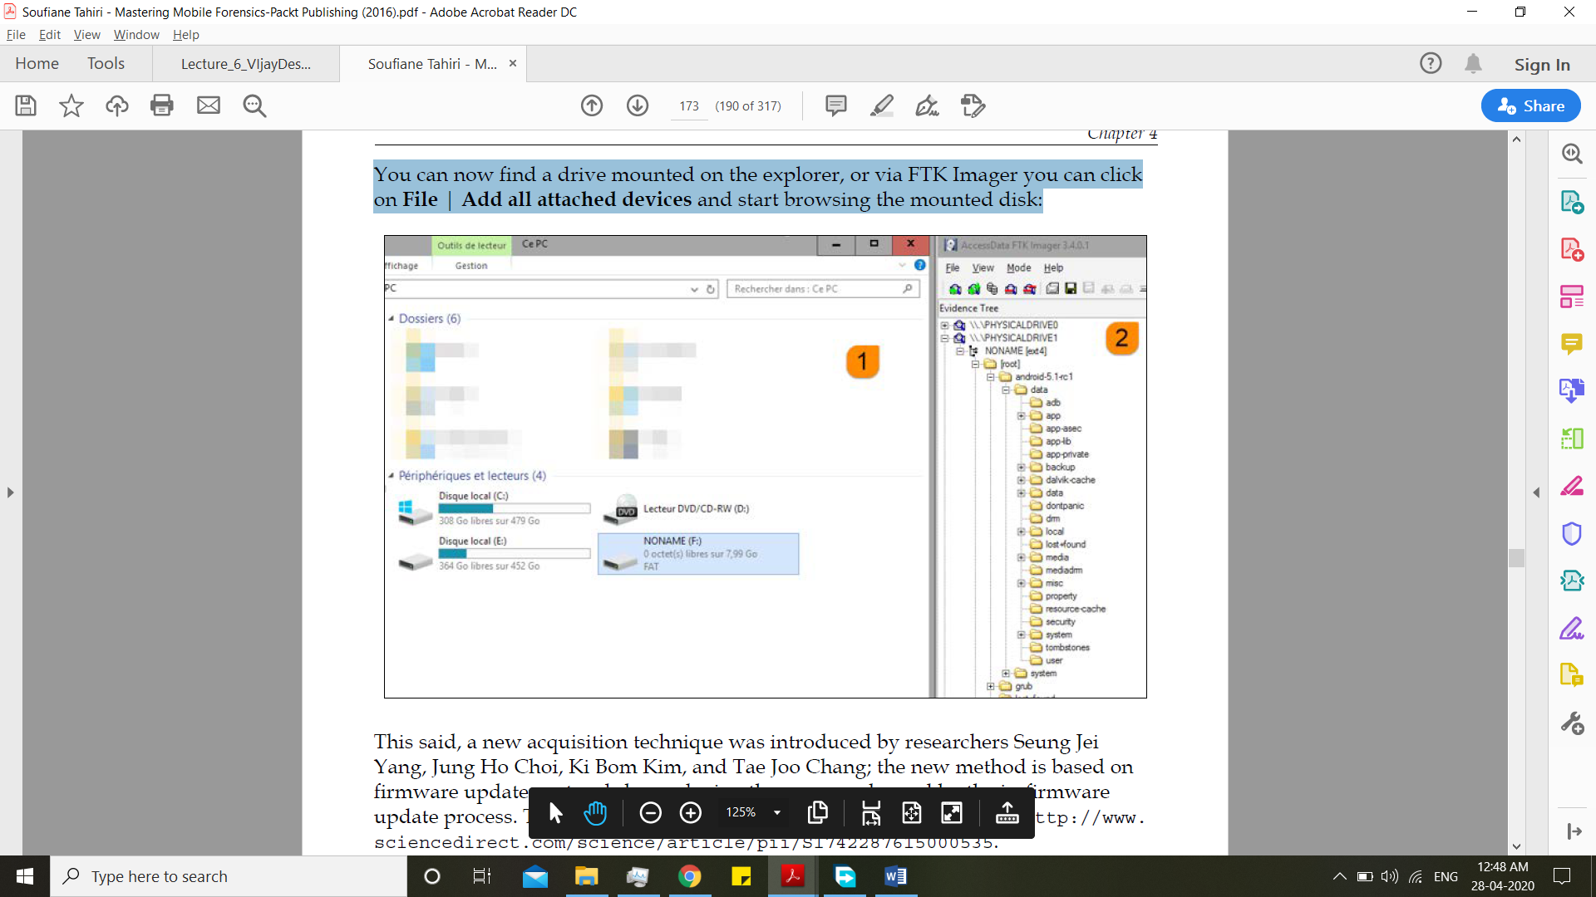
You can now find a drive mounted on the explorer, or via FTK Imager you can click on File | Add all attached devices and start browsing the mounted disk:

Slide 21
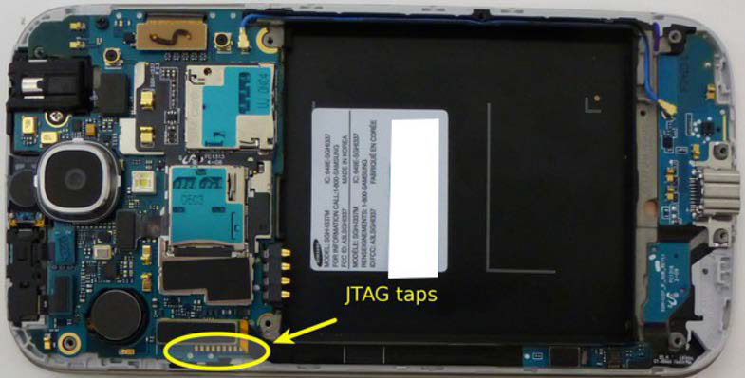
JTAG forensic examinations
We can also use JTAGs hardware at the back of mobile phones to forensic. It is also called Chip Off Forensic Examination.

Slide 22
Summary:
We had a look at the Android architecture and its security models, how they are inherited and implemented.
We saw how disk encryption has evolved through Android versions, and how Android deals with sandboxes, SELinux, and application signing.
Then we discussed various techniques for bypassing lock screens and how to crack PINs and passwords.
How we can acquire (logically and physically) an Android image and how we can analyze it using a free and open source tool (Autopsy), and introduced the JTAG and chip-off techniques.

Slide 23
References:
Mastering Mobile Forensics, Soufiane Tahiri Packt Publication 2016
https://source.android.com/security/encryption/full-disk
https://androidfilehost.com/?fid=95784891001607611
https://source.android.com/security/selinux
https://github.com/c0d3sh3lf/Android_Forensics

Slide 24
Thank You

